Slide 1
ON THE IMPACT OF DIFFERENT WORD EMBEDDINGS ON METAPHOR DETECTION
Giorgio Ottolina – 838017
Laurea Magistrale in Data Science

Slide 2
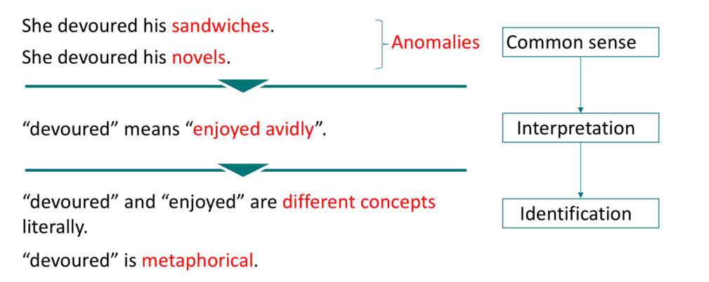
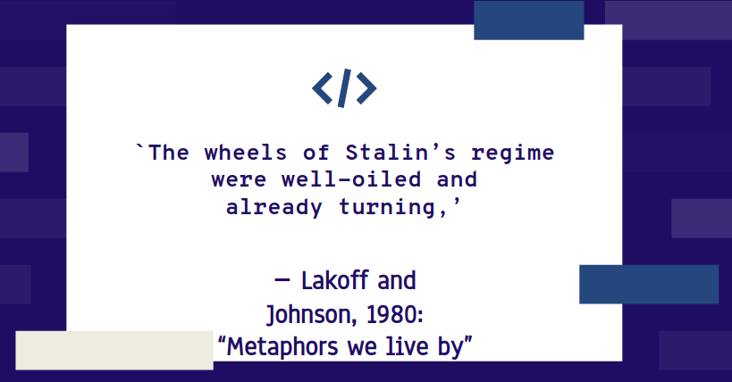
Conceptual Metaphor Theory (CMT) -Lakoff and Johnson - Metaphor:
not just property of language, but cognitive mechanism; knowledge projection process
Link between metaphors and language evolution
Metaphor Detection
Metaphor Classification
Procedures
In single sentence
In discourse
contrast between a word’s contextual and literal meanings
contrast between a target word and its context
Goal → identify all metaphorical words inside a sentence
Notes:
Introdurre il problema (metafore cosa sono e approcci computazionali alla loro soluzione
Metaphor classification
Metaphor interpretation - rappresentazioni vettoriali dei significati delle parole - word embeddings / idea: riconoscere parole usate in contesti inusuali

Slide 3

WORD EMBEDDINGS
INTUITION
Vector representations computed with different models on different corpora
CORE MEANINGS
GloVe & Word2Vec
CONTEXTUAL
BERT & ELMO
Words’ core meanings change over time → depend on corpus and time
Specific words’ meanings can be learned using specific temporal slices
Notes:
Methodology 2:
Explain choice of corpora // alignment methods

Slide 4
OVERVIEW
Explorative analysis based on word embeddings
Quantitative analysis → impact of embeddings on metaphor detection
Qualitative analysis → model’s predictions
New hypotheses to improve metaphor detection
THESIS OBJECTIVES
Notes:
Objectives of the thesis

Slide 5
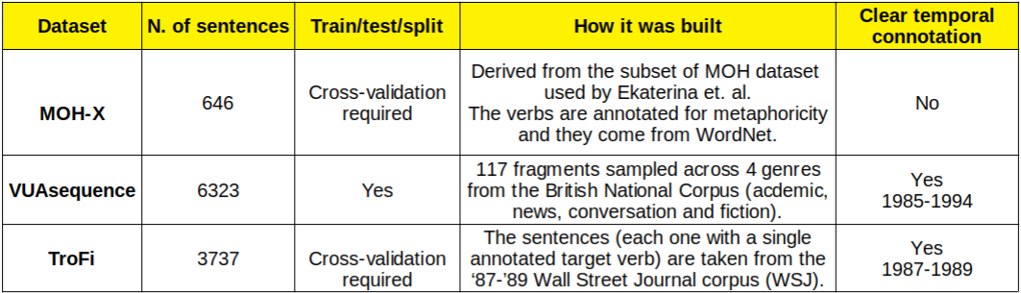
METHODOLOGY - INTRO
1900 - 2000
Procrustes
CADE - Compass
Metaphor Detection Models
Word Embeddings Model + Corpus
Decade + Alignment Model
Datasets
LSTMs – RNN HG (MIP) and RNN MHCA (SPV) [Gao & al.2019]
Word2Vec - CoHa (word + lemma)
Word2Vec - Wikipedia
GloVe
ELMO
Notes:
methodology: intro:
Scelta modello neurale
Scelta datasets usati in previous work (temporal connotation vs no) Scelta corpora / slices e modelli di allineamento

Slide 6
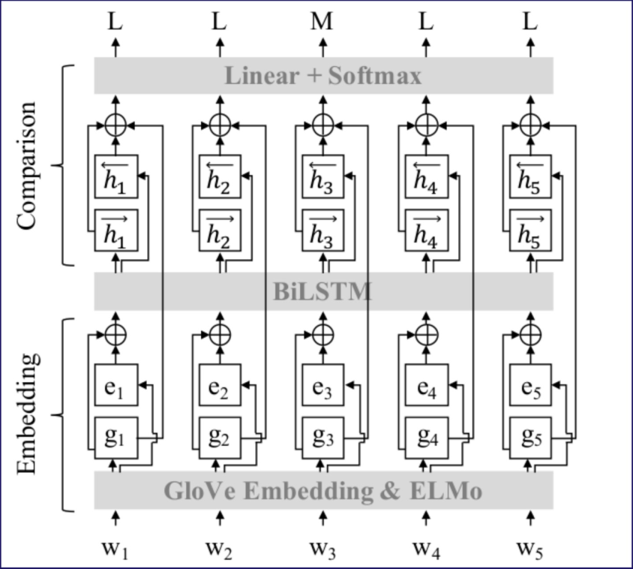
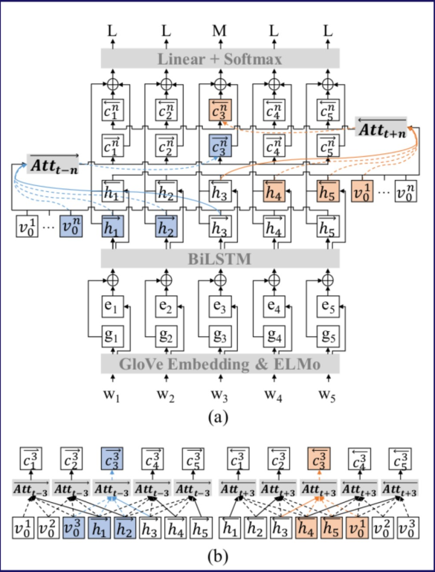
METHODOLOGY
RNN HG & RNN MHCA models - Rui Mao et al. (2019) for Sequential Metaphor Identification:
RNN HG → better with Temporal Embeddings
RNN Hidden Glove
RNN Multi-Head Context Attention
MIP procedure: metaphor is classified by contrast between a word’s contextual (hidden state) and literal (GloVe) meanings
SPV procedure:
metaphorical label prediction conditioned on a hidden state of a target word and its attentive context representation
Notes:
Methodology 1 (slide 1/ 2)
Scelta modello stato dell’arte neurale (HG) 2018
HG / MHCA - prestazioni motlo simili
Spiegare

Slide 7
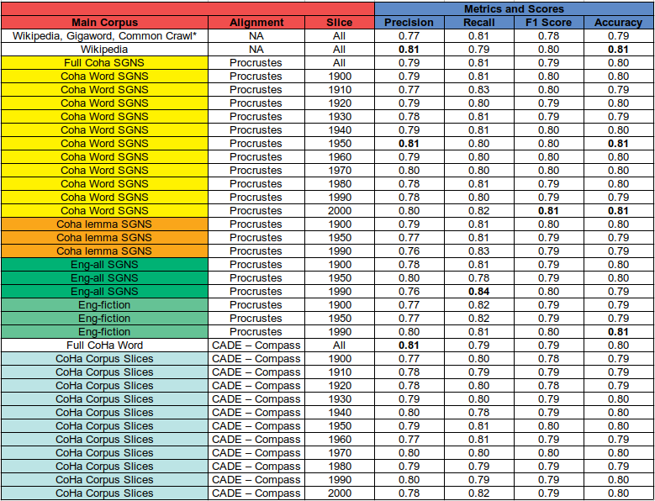
MOH-X
GloVe
Wikipedia > GloVe;
Precision > Recall
CoHa Word → best SGNS slices; generally better than GloVe; Recall > Precision
No clear temporal connotation, from wordnet (from 199x and by lexicographers);
Recent slices a bit better
CADE = other embeddings; MOH-X → best dataset

Slide 8
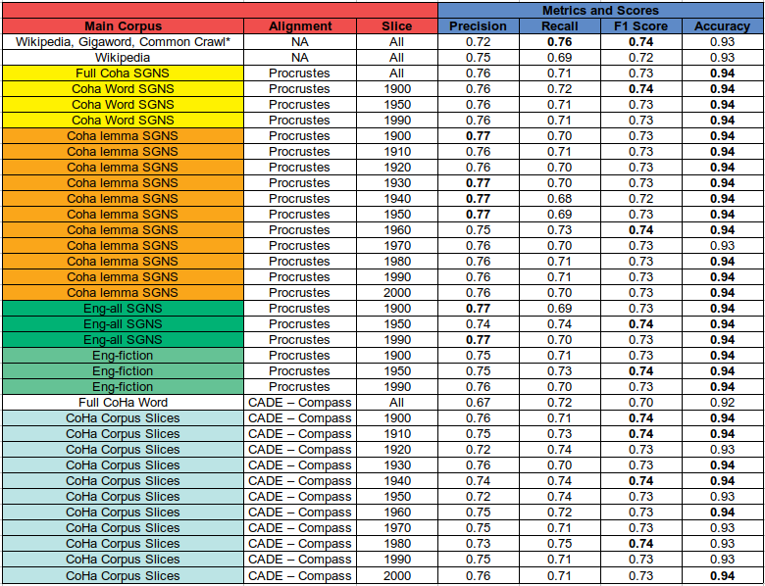
VUA
GloVe
Wikipedia < Temporal
CoHa Lemma → best SGNS slices;
Precision > SOTA;
Recall drops
From BNC (1985 - 1994) - four genres - algorithm-annotated statements;
middle slices are a bit better
Almost on par with Wikipedia and SGNS;
Procrustes > CADE

Slide 9
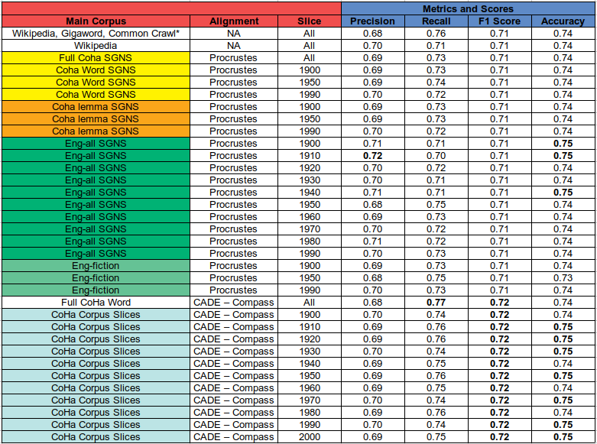
TROFI
GloVe
Wikipedia < Temporal
From 87-’89 Wall Street Journal Corpus (WSJ);
old middle seem to have a better balance
Eng-All → best SGNS slices;
Precision increases with time and recall drops, except for Eng-All SGNS 1910
Generally better than SGNS;
F1 scores from 71% to 72%; CADE > Procrustes

Slide 10
OVERALL PERFORMANCES
Word2Vec > GloVe
SGNS > GloVe
SGNS > Wikipedia (TroFi and VUA)
MOH-X → generally the best dataset
CADE alignment → better with TroFi dataset
Procrustes alignment → better with VUA dataset
RESULTS OVERVIEW
Notes:
Experimental results - overview

Slide 11
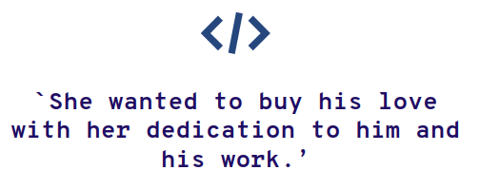
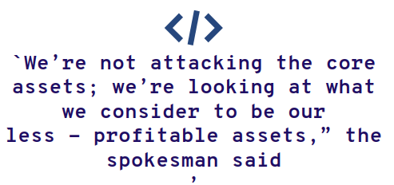
QUALITATIVE ANALYSIS - 1
Core meanings used in economical/political and emotional/feelings contexts. (MOH-X)
Physical (core meaning) verbs → metaphorical in economical and emotional contexts. (TroFi)
Nearest Neighbors Analysis:
Words most similar to predictions

Slide 12
QUALITATIVE ANALYSIS - 2
Core meanings used in economical, political and emotional contexts → most frequently identified
Physical (core meanings) verbs → metaphorical if used in previous contexts
CoHa (SGNS) 1990 slice → no `news’ genre correct predictions. Metaphorical representations bias?
RESULTS OVERVIEW
Notes:
Qualitative analysis

Slide 13

CONCLUSIONS
Contextual word embeddings (BERT) → fine-tuned model trained on state of the art datasets: Metaphorical sentences classification on new test set (LCC dataset).
Core meanings → Economics, politics and emotions contexts
Word2Vec temporal word embeddings > GloVe with specific temporal ranges and slices
Core meanings/Contexts qualitative analysis patterns
Future research: new ad hoc dataset with words with known semantic changes & more BERT experiments
Notes:
Conclusions & Future Future work:

Slide 14
THANK YOU FOR YOUR ATTENTION!

